Slide 1


REVENUE SOURCES
  What are those sources?
  How are the amounts calculated?
  When are they distributed?

Slide 2


CHARTER SCHOOL FUNDING IN IDAHO
In general:
90% of your funding is typically directly from the state, funded by annual legislative appropriation
  The legislature likes to achieve legislative goals by directing most of the funds to specific activities, purposes, and programs
  This makes the “funding formula” complicated
  Results in less flexibility
  10% of your funding is typically Federal Funds including Title 1, Title 2, Title 3, Title 4 and IDEA (Special Education)

Slide 3
CHARTER SCHOOL FUNDING IN IDAHO
Charters often secure grant support from a variety of additional sources, including:
  State or national philanthropic organizations (JKAFF, Calder, New School Venture Fund, Charter School Growth Fund, and others)
  Federal Charter School Program grants
  Targeted Federal grant programs – E-Rate (technology), Rural Education Achievement Program (REAP) Small, Rural School Achievement (SRSA) and Rural and Low-Income Schools (RLIS) grant awards
  Fundraising

Slide 4
THE “FUNDING FORMULA”
Most of the funding is driven by a concept called “Support Units”; support units are computed based on “Enrollment” reduced by “Average Daily Attendance”, so in essence, by Attendance (“Seat time”).
Idaho Code 33-1001(2) states “Average daily attendance” or “pupils in average daily attendance” means the aggregate number of days enrolled students are present, divided by the number of days of school in the reporting period; provided, however, that students for whom no Idaho school district is a home district shall be considered in such computation.
* This may change to an average enrollment measure, currently being debated by our legislators

Slide 5

CALCULATING SUPPORT UNITS
The ADA divided by a Divisor = Support Unit
§§ Unit Calculation Table (IC 33-1002)
§§ A divisor takes the size of the District/Charter based on ADA per Grade grouping into consideration:
§§ Kindergarten
§§ Elementary
§§ Secondary
§§ Exceptional Child
§§ Alternative
§§ Minimum Units are used for equalization

Slide 9
FUNDING SOURCES - STATE
State dollars can be grouped as follows:
“Entitlement” – unrestricted funds, approximately $29,000 per support unit, approximately 23% of state funding
Salary Apportionment – approximately 48% of state funding
Benefit Apportionment - approximately 9% of state funding
Transportation – depends on costs, but generally 5% of state funding
Charter School Facilities - approximately 7% of state funding
All other “special distributions” – (20 of them can apply to charters) approximately 8% of state funding

Slide 10
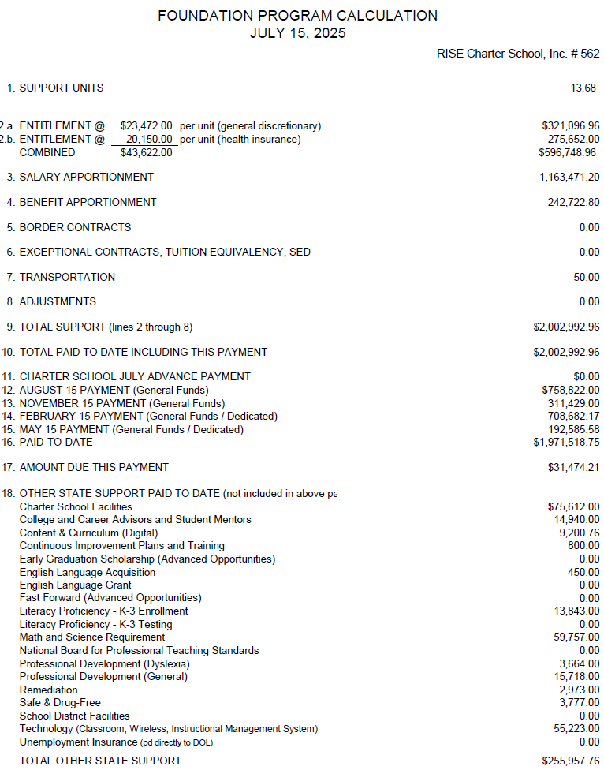
This is the annual report format showing all of the funding sources. This example is RISE for FY2025.

Slide 11
SCHOOL FUNDING – “ENTITLEMENT”
What are these funds typically used for?
Curriculum
Facilities costs in excess of facilities funding – janitorial, utilities, etc.
Transportation costs that exceed transportation funding
Food service costs that are greater than food service revenue/reimbursement
Special education costs that exceed Medicaid and IDEA funding
All employee benefits except FICA, Medicare, and PERSI
Supplies
Charter commission fees, audit fees, insurance, etc.

Slide 12
SCHOOL FUNDING–
SALARY BASED APPORTIONMENT
The state multiplies support units times fixed factors to determine how many equivalent FTE's wil be funded:
Category | Support Units | Fixed Factor | Resulting FTE | Then the factor is multiplied times the allowed salary per each category.
Administrative | 11.24 | 0.075 | 0.84 | x $39,390 x your administrator(s)' index = $54,185
Instructional Staff | 11.24 | 1.020 | 11.47 | x Weighted Avg Career Ladder Salaries for your Staff = $511,740
Pupil Service Staff | 11.24 | 0.079 | 0.89 | x Weighted Avg Career Ladder Salaries for your Staff = $34,630
Classified Staff | 11.24 | 0.375 | 4.21 | x Fixed amount: $23,376 per FTE = $96,877

Slide 13
SCHOOL FUNDING–
SALARY BASED APPORTIONMENT
Important Factors to Remember:
Your pay scale does not have to follow the career ladder *, or the funding mix. I'll explain further.
You can hire more or less teachers, but you have to balance all the categories of funding. Want examples?
If you add up all your staff costs and they are less than your computed allocation, the SDE will pay the salary-based apportionment. But if your actual staff costs exceed the apportionment, then the excess will NOT be funded.
Charters have a benefit over districts - districts have a "use it or lose it“ provisions.
* But you must pay teachers a minimum salary per law.

Slide 14
SCHOOL FUNDING –
BENEFIT APPORTIONMENT
The benefit apportionment pays the following benefits:
FICA | 6.20%
Medicare | 1.45%
PERSI | 11.94%
Total | 19.59%
BE AWARE:
The payment is based on 19.59 % times THE LESSER of actual salaries or the salary apportionment. So, if your salaries exceed the apportionment, you will not receive this funding. If your salaries are less than the apportionment, you will receive the full apportionment, but 19.59% of the actual salaries.
All other benefits come out of "Entitlement" funds, including PERSI Retirement Sick Pay Contribution

